Slide 1
Basic Branching and Merging

Slide 2
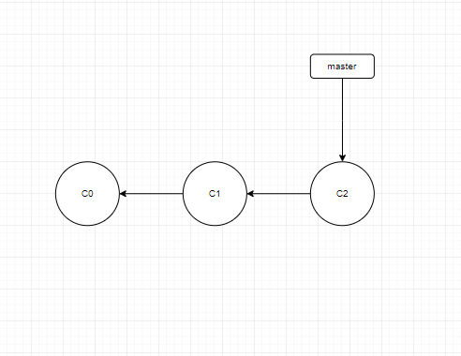
A simple commit history

Slide 3
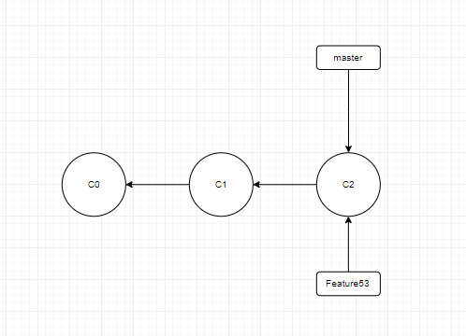
Creating a new branch pointer

Slide 4
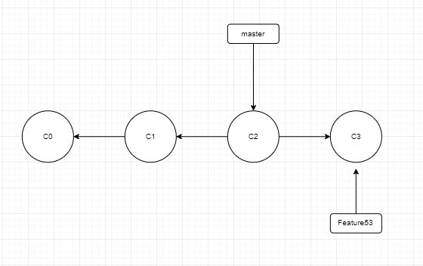
The Feature53 branch has moved forward with your work

Slide 5
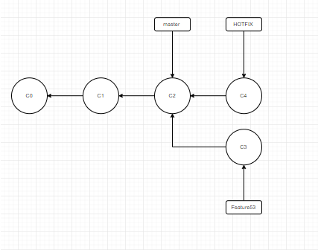
Hotfix branch based on master

Slide 6
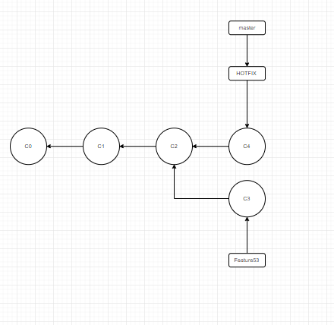
master is fast-forwarded to hotfix

Slide 7
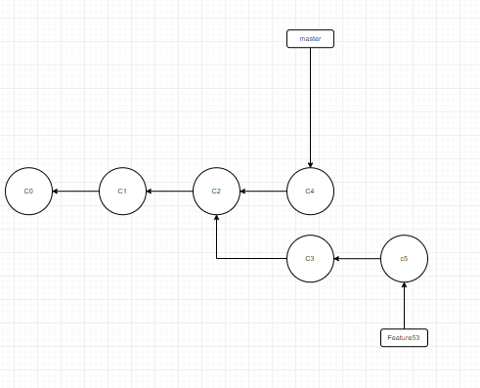
Work continues on Feature53

Slide 8
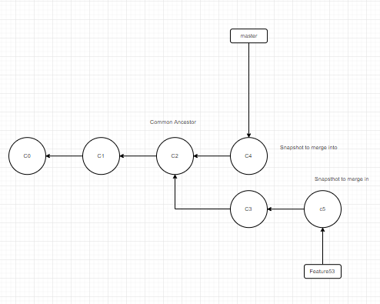
Three snapshots used in a typical merge

Slide 9
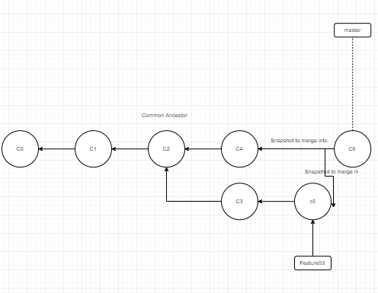
A merge commit

